Slide 1
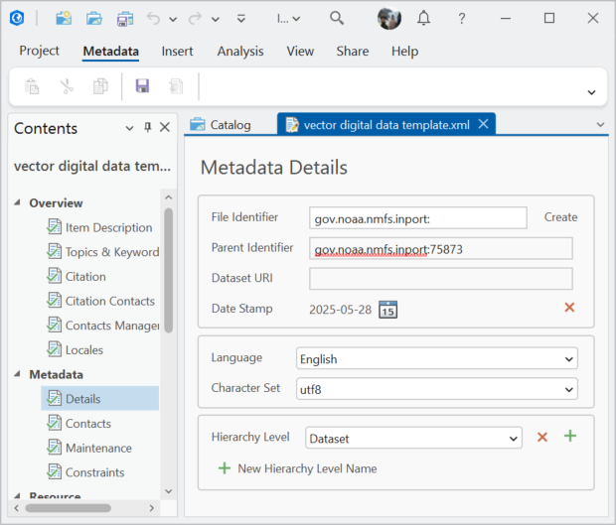
The GIS user creates a new ArcGIS Metadata record, using the Metadata Editor in ArcGIS Pro, for all datasets that will have metadata records loaded to InPort
The user then searches the InPort website to find the project that the metadata records will be placed under
The catalog id is then recorded in the ArcGIS Metadata element
Each ArcGIS Metadata record is checked for the presence of the mdParentID element using Python. If missing, then the element is added and populated
Updating the InPort API search function so that it is possible to get the catalog id for a specific project (load new datasets metadata) or a dataset (updating existing datasets metadata) would be very useful

